Slide 1
Stock-out Prediction in Multi-echelon Networks

Slide 2
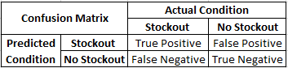
Stockout prediction - Multi-echelon networks
Objective: Stockout Prediction for each node of the network
Network Structure: Serial Network
Simulated Data Assumptions:
Manufacturer(Upstream) = 1, Distribution Center = 9, Customer(Downstream) = 1
Time period = 4 years ; Service Level = 80%
Dataset Structure: Imbalanced Dataset
Model: 3 Naive Algorithms, XGBoost, Random Forest
Evaluation Metrics: F1 score = 2* Precision + Recall / (Precision + Recall)
 | Stockout | No Stockout
Count | 1402 | 13208
Notes:
Mention its for each of the node
Upstream - Third party vendors - unlimited source of raw materials and goods
Downstream - Customer end - External Stochastic Demand
A supply disruption upstream will have an effect on downstream, customer-facing nodes several periods later as the disruption "cascades" through the system.
SSM - demand follows a known probability distribution

Slide 3
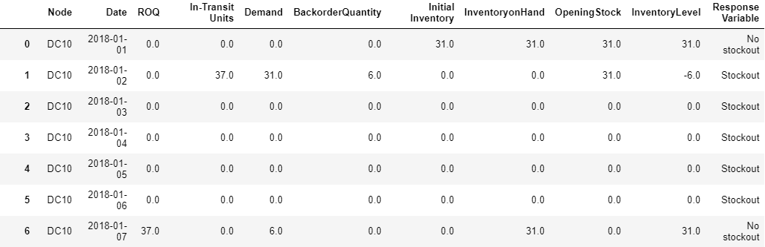
Data Preprocessing
Combined simulated data to prepare inputs and outputs for building predictive models
Inventory on Hand = Max (0, (Opening Stock - Demand + ROQ)
Inventory Level = Inventory on Hand - Backorders
Response Variable: Stockout = Inventory Level <=0

Slide 4
ML Algorithms - XGBoost, Random Forest, LSTM, TCN
Input - [f_{t}¹,... f_{t}^{p}; [IL_{i}, IT_{i}]^{t} _{i=t-k+1}]
Inventory Level (IL_{i}) = On-hand Inventory - Backorders
Inventory-in-Transit (IT_{i}) = Items shipped from upstream node but not yet received by the downstream node
k most recent periods of the stock-out information
Output
Stock-out prediction for time (t+1) for each node of the network
XGBoost(eXtreme Gradient Boosting)
Trees are built sequentially
Regularization Feature - prevents in overfitting
Random Forest
Builds decision trees in parallel
Long short term memory network(LSTM)
Overcome exploding and vanishing gradient problems that occurs in RNN
Temporal CNN(TCN)
Efficiently computes sequential data using 1-d CNN
Notes:
XGBoost follows the principle of Gradient Boosting, where the decision trees are built sequentially such that each subsequent tree aims to reduce the errors of the previous tree
However, Random Forest follows the Bagging techniques, where the decision trees are built in parallel and the average of the predictions are considered as final predictions

Slide 5
Results - F1 Score
Nodes | Naive Algorithm 1 | Naive Algorithm 2 | Naive Algorithm 3 | Random Forest | XGBoost Baseline | XGBoost with Oversampling | XGBoost with Oversampling and Dependent Nodes Features
DC2 | 0.75 | 0.12 | 0.59 | 0.54 | 0.62 | 0.69 | 0.79
DC3 | 0.60 | 0.11 | 0.42 | 0.63 | 0.69 | 0.68 | 0.62
DC4 | 0.43 | 0.25 | 0.33 | 0.52 | 0.60 | 0.60 | 0.67
DC5 | 0.72 | 0.11 | 0.56 | 0.66 | 0.72 | 0.71 | 0.70
DC6 | 0.66 | 0.10 | 0.50 | 0.64 | 0.69 | 0.71 | 0.72
DC7 | 0.56 | 0.19 | 0.42 | 0.62 | 0.67 | 0.65 | 0.68
DC8 | 0.67 | 0.09 | 0.47 | 0.47 | 0.55 | 0.61 | 0.70
DC9 | 0.78 | 0.09 | 0.62 | 0.60 | 0.69 | 0.78 | 0.70
DC10 | 0.62 | 0.03 | 0.51 | 0.50 | 0.67 | 0.72 | 0.73
MFG11 | 0.73 | 0.31 | 0.50 | 0.53 | 0.57 | 0.68 | 0.70
Avg | 0.65 | 0.13 | 0.49 | 0.57 | 0.65 | 0.68 | 0.70

Slide 6
Thank you

